Slide 1
World trends

Slide 2
Life Expectancy vs Fertility
You are required to produce a scatterplot depicting Life Expectancy (y-axis) and Fertility Rate (x-axis) statistics by Country.
The scatterplot needs to also be categorised by Countries’ Regions
You have been supplied with data for 2 years: 1960 and 2013 and you are required to produce a visualisation for each of these years. Some data has been provided in a csv file, some - in R vectors.
The csv file contains combined data for both years. All data manipulations have to be performed in R (not in excel) because this project may be audited at a later stage.
You have also been requested to provide insights into how the two periods compare

Slide 3
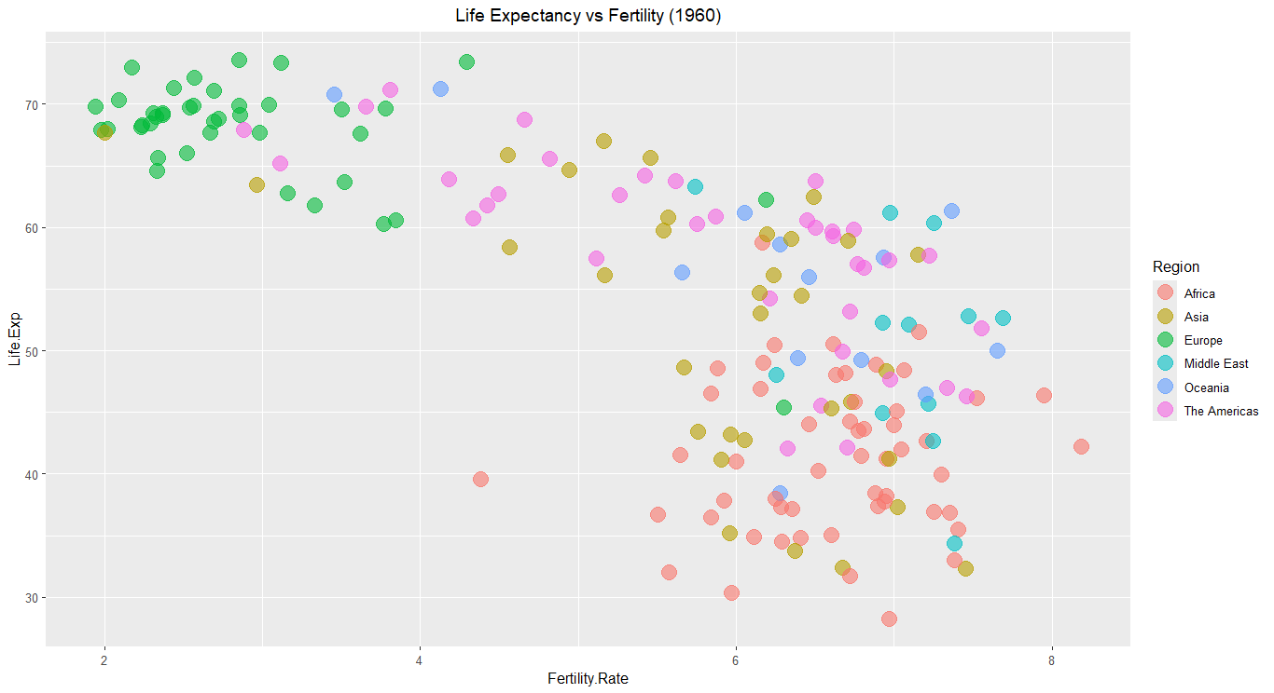

Slide 4
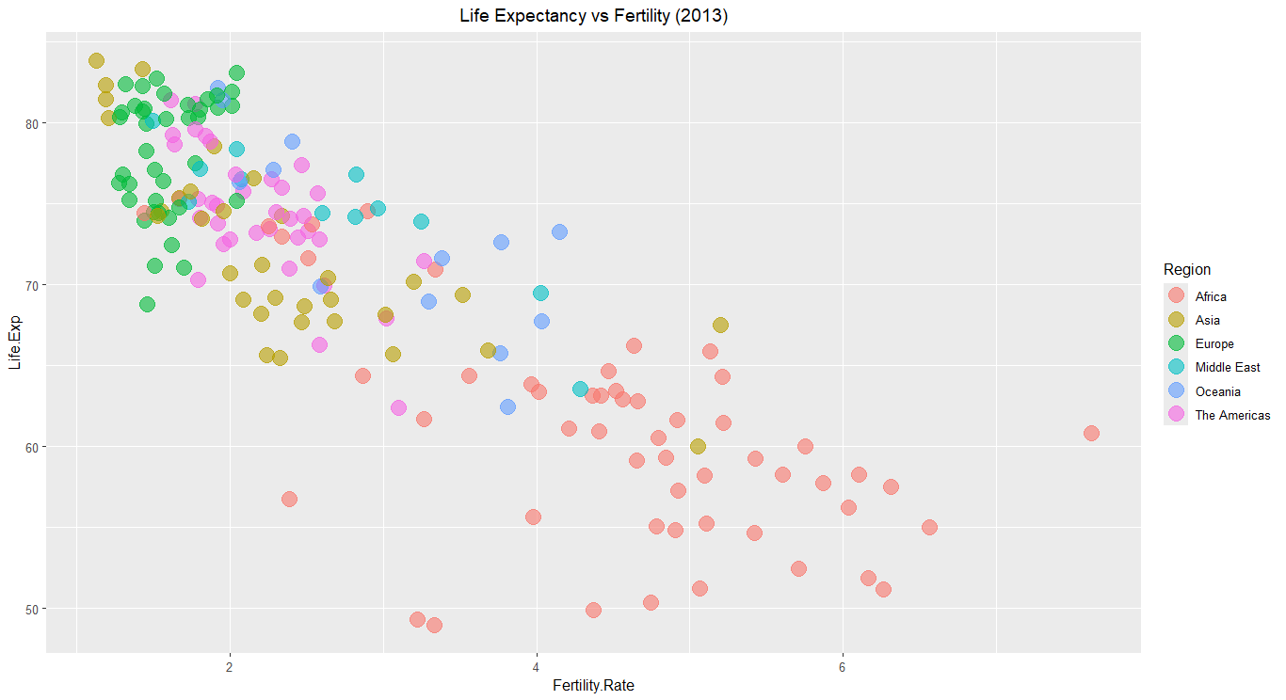

Slide 5
Conclusion
Life Expectancy vs Fertility Insights:
  Over the years, a clear inverse relationship has been observed between life expectancy and fertility rates.
  The comparison between 1960 and 2013 shows that :
    1960:Countries with higher fertility rates tended to have lower life expectancy
    2013: Fertility rates have generally decreased, while life expectancy has significantly increased, reflecting advancements in healthcare and economic development.
Regional trends
  Develop nations: Consistently show lower fertility and higher life expectancy across both periods.
  Developing nations: While life expectancy has improved, fertility rates remain higher than in developed countries, though they have declined significantly since 1960.

Slide 6

Implications
The data reflects a global shift towards lower fertility and higher life expectancy, with most regions following this trend albeit at different paces.
These trends are crucial for understanding future population growth, economic development, and the challenges posed by aging populations in some regions.

Slide 7
Future Considerations
  As life expectancy continues to rise and fertility rates drop, nations will need to address issues related to aging populations, healthcare sustainability, and workforce shortages.

